Slide 1



FLAPPY BIRD GAME
Submitted by :
S. Gopal Reddy
HU21CSEN0500086
Under the guidance of :
Dr. Sreerama Murthy.M
Department of computer science and engineering
GITAM(Deemed to be university)
Hyderabad-502329
December 2023

Slide 2
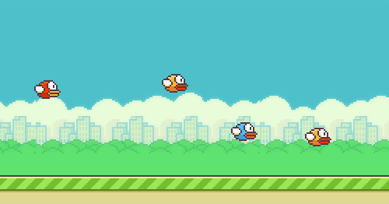
TABLE OF CONTENTS
About the project
Tools and Technologies used
References
Output
Start screen
Game play screen
Game over screen

Slide 3
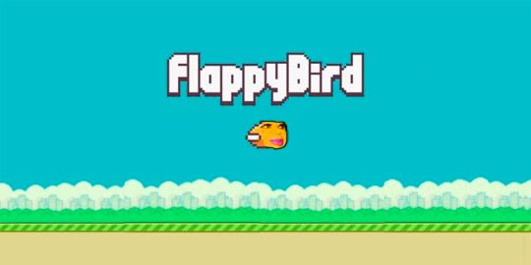
ABOUT THE PROJECT
FLAPPY BIRD:
Flappy Bird is a classic mobile game that gained widespread popularity for its simplicity and addictive gameplay. Created by Vietnamese developer Dong Nguyen and released in 2013, the game features a small bird that players navigate through a series of pipes by tapping the screen. The objective is to keep the bird airborne and avoid collisions with the pipes, challenging players with its deceptively simple mechanics.

Slide 4
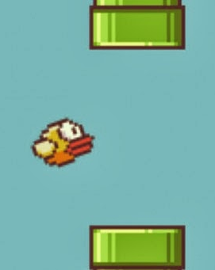
ABOUT THE PROJECT
FLAPPY BIRD:
The game's minimalistic design, coupled with its difficulty, contributed to its rapid rise in popularity. Flappy Bird became a cultural phenomenon, generating millions of downloads and inspiring a wave of imitations. Despite its success, Nguyen decided to remove the game from app stores in 2014, citing concerns about its addictive nature. Flappy Bird remains a notable example of a mobile gaming sensation, leaving a lasting impact on the gaming community.

Slide 5
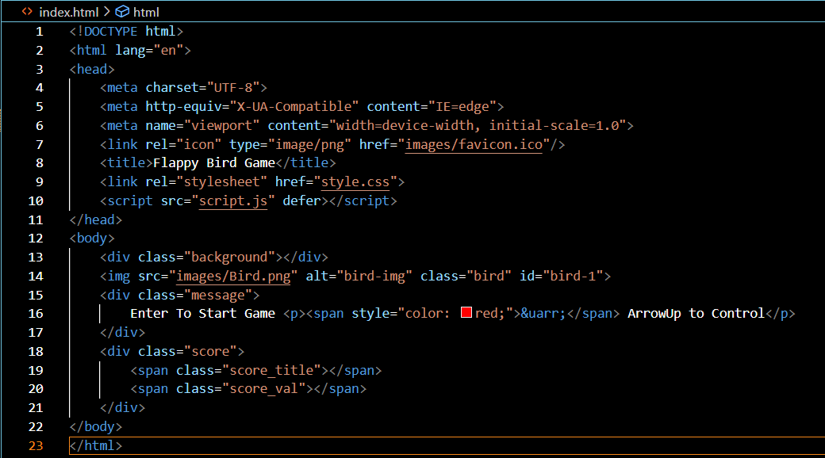
TOOLS AND TECHNOLOGIES USED
1.HTML
2.CSS
3.JAVASCRIPT

Slide 6
TOOLS AND TECHNOLOGIES USED
HT ML:
Canvas: The foundation for drawing the game elements.
Score Display: Elements to show current and best scores.
Game Over Message: A container for displaying the game over message.

Slide 7
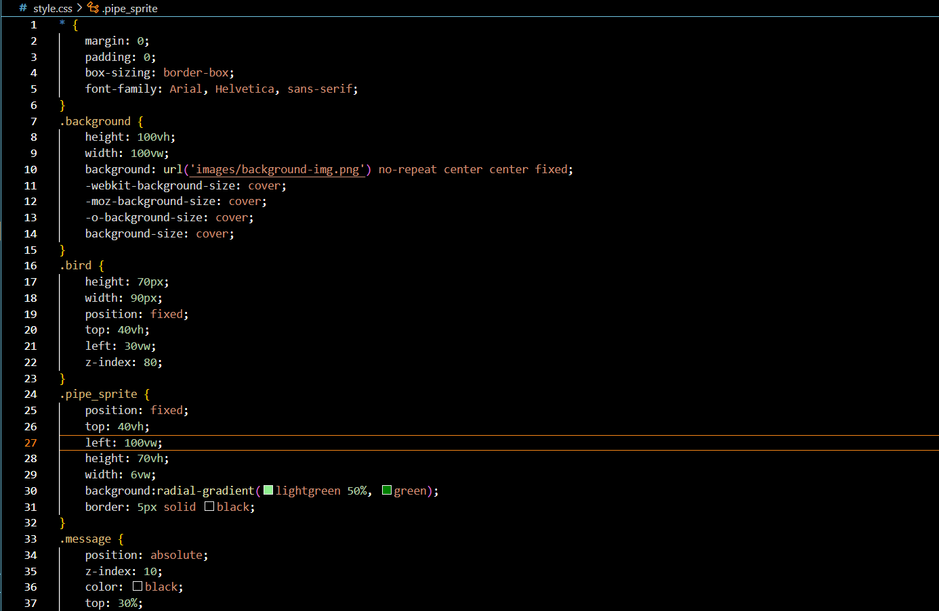
TOOLS AND TECHNOLOGIES USED
CSS:
Positioning Elements: Arranging elements within the game area.
Visual Appeal: Enhancing graphics and text appearance.
Responsiveness: Ensuring proper display across different screen sizes

Slide 8
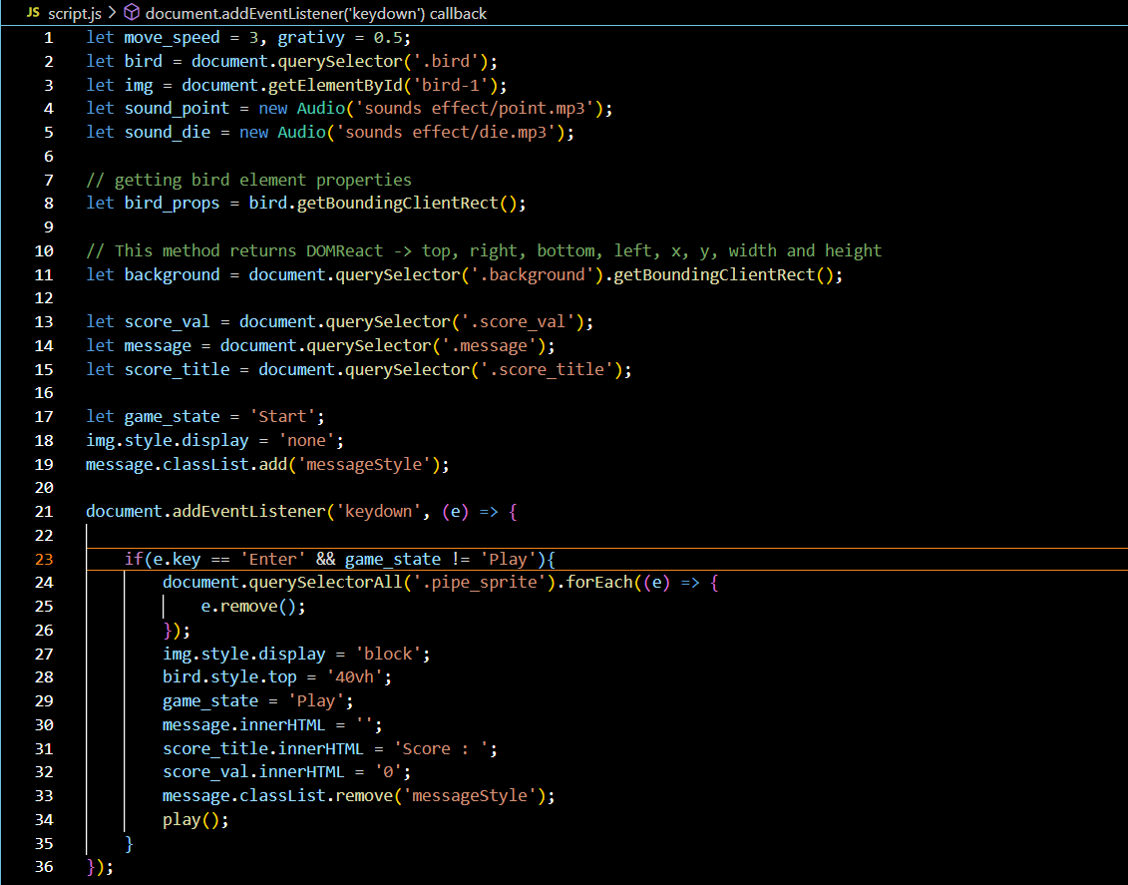
TOOLS AND TECHNOLOGIES USED
JavaScript :
GAME ELEMENTS:
Bird: Creation, animation, and movement control using user input.
Pipes: Generation, positioning, and movement across the screen.
Background: Display of a static or moving background image.
GAME MECHANICS
Gravity: Simulating downward pull on the bird.
User Input: Detecting spacebar or mouse clicks to make the bird flap.
Collision Detection: Checking for bird-pipe or bird-ground collisions.
Scoring: Tracking scores and updating display elements.
Game Over: Transitioning to the game over state upon collision.

Slide 9
TOOLS AND TECHNOLOGIES USED
JavaScript :
GAME LOOP:
Continuous Updates: Repeatedly executing game logic to maintain animation and interactivity.
Key Features:
Simple Graphics: Using basic shapes and images for visual elements.
Single-Screen Gameplay: No levels or transitions, fostering focus on core mechanics.
Challenging Difficulty: Attaining high scores requires precise timing and control.
Addictive Gameplay: Easy to learn but difficult to master, encouraging repeated play.
Additional Features (Optional):
Sound Effects: Enhancing gameplay experience with audio feedback.
Power-Ups: Introducing temporary abilities or score multipliers.
Leaderboards: Allowing players to compete with others for high scores.

Slide 10
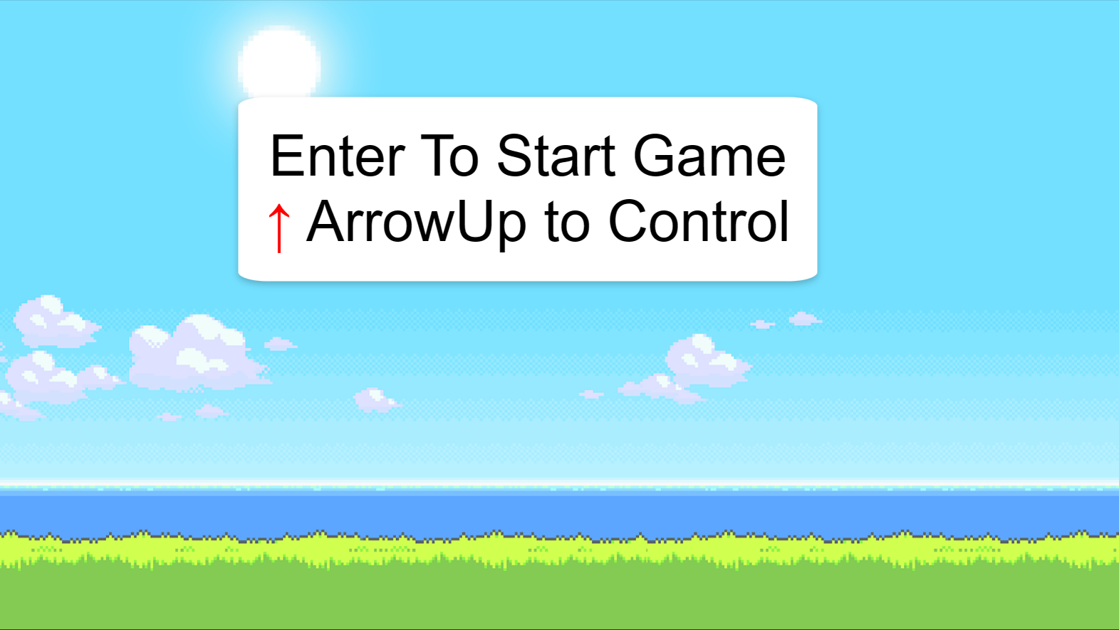
OUTPUT
START SCREEN

Slide 11
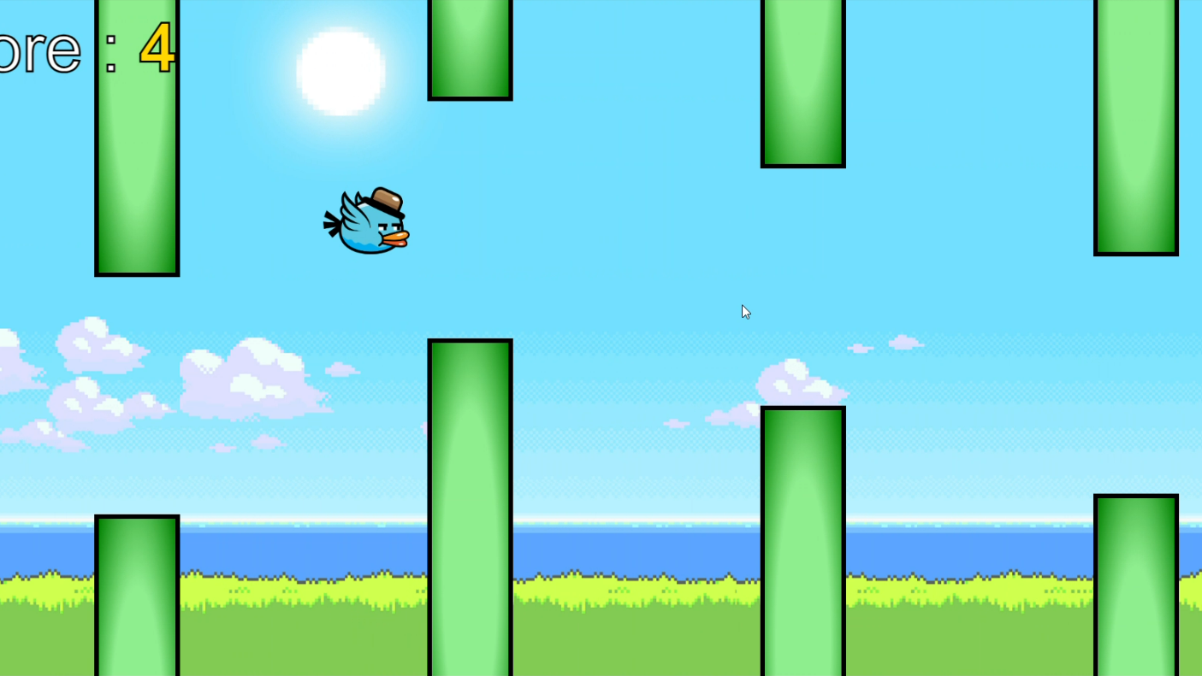
OUTPUT
GAME SCREEN PLAY

Slide 12
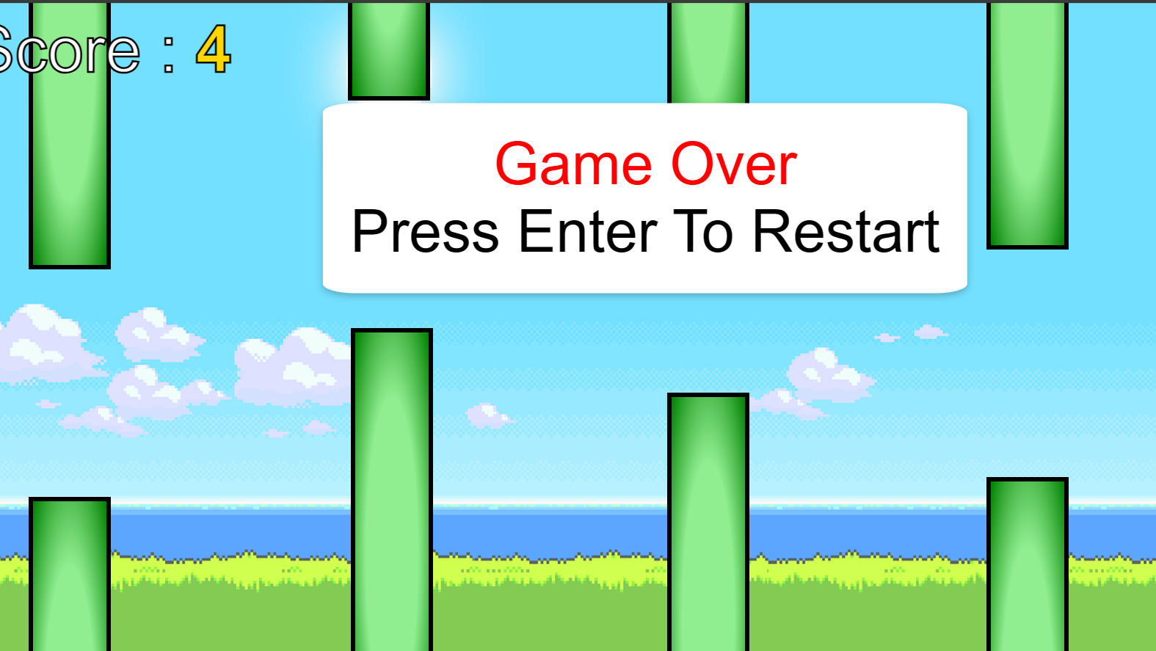
OUTPUT
GAME OVER SCREEN

Slide 13


